Slide 1
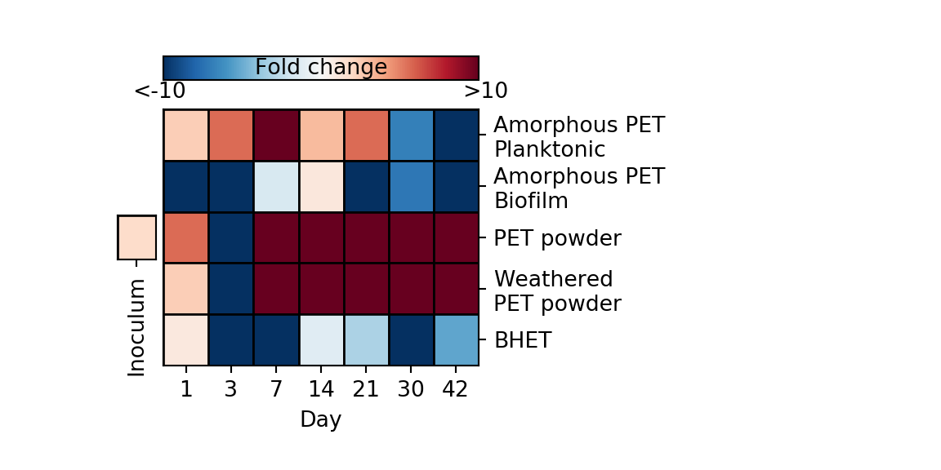
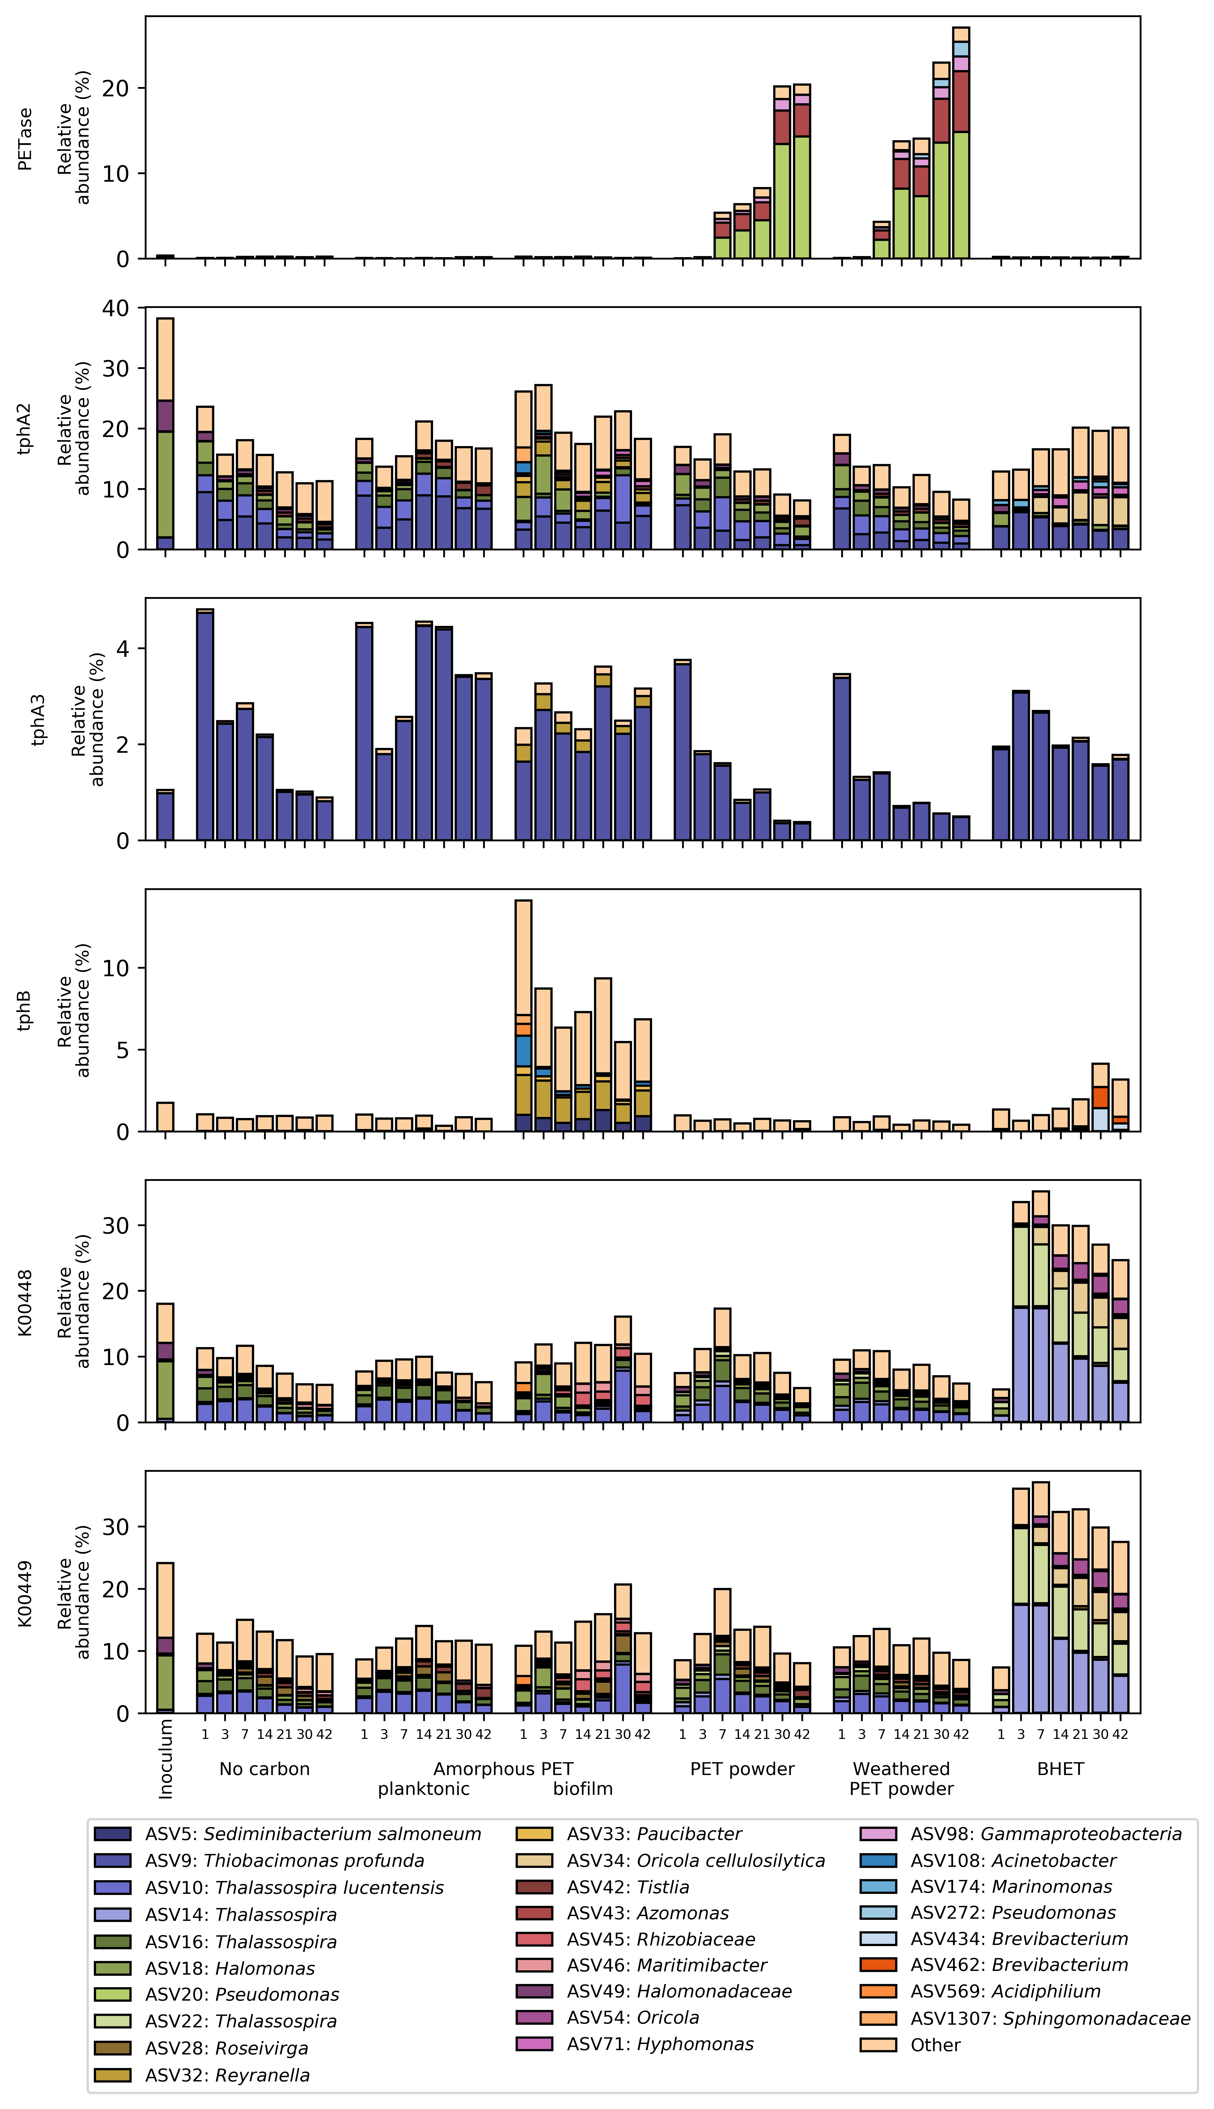
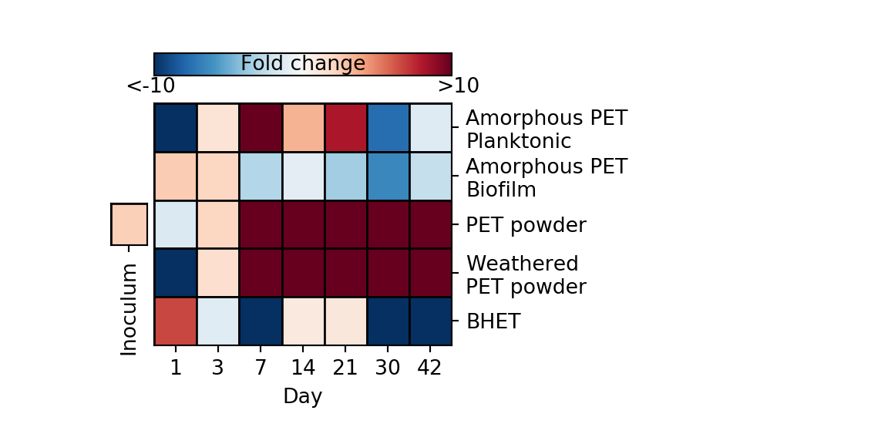
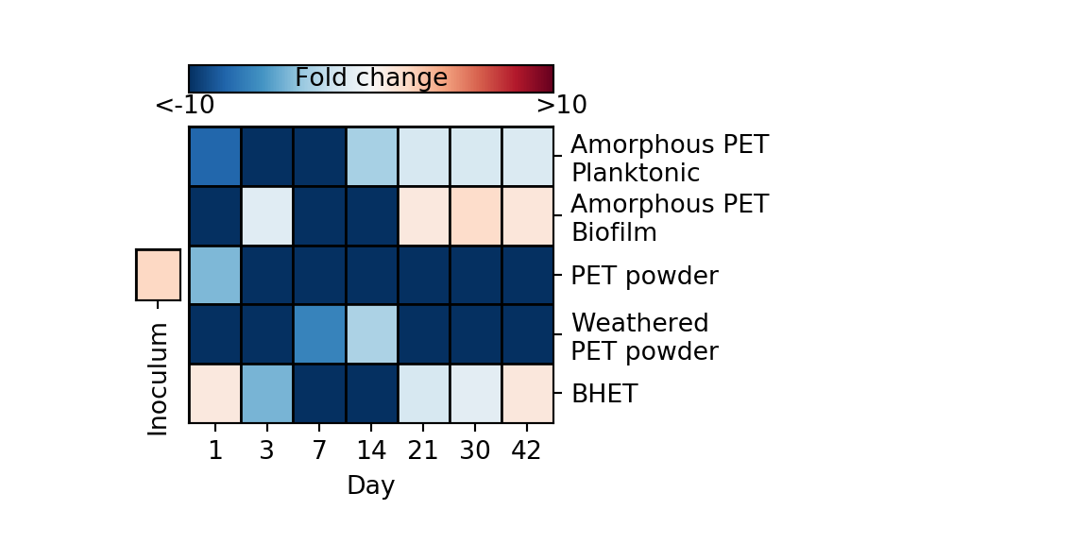
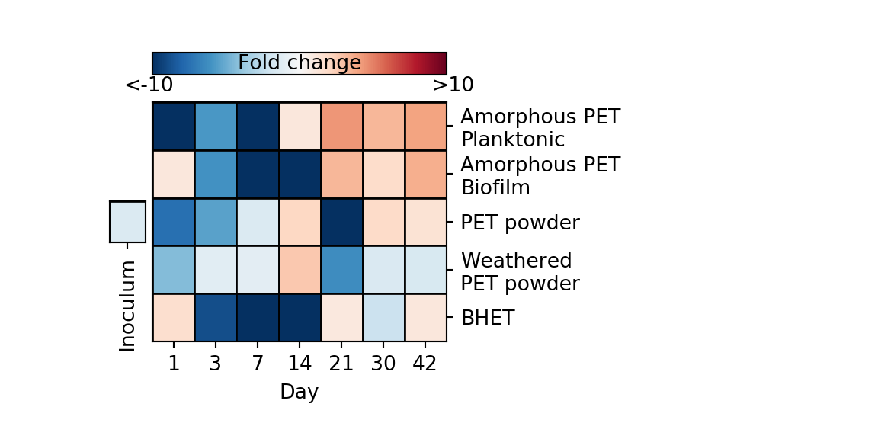
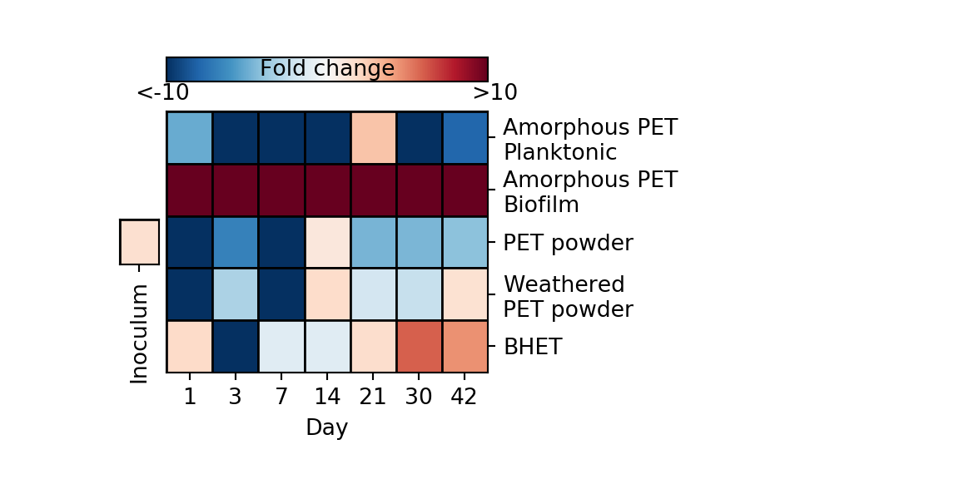
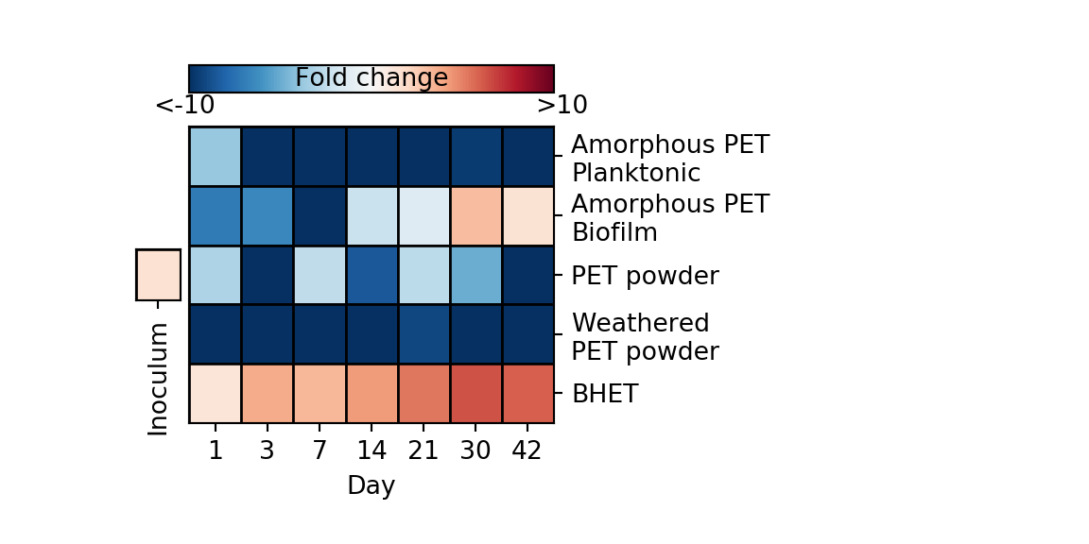
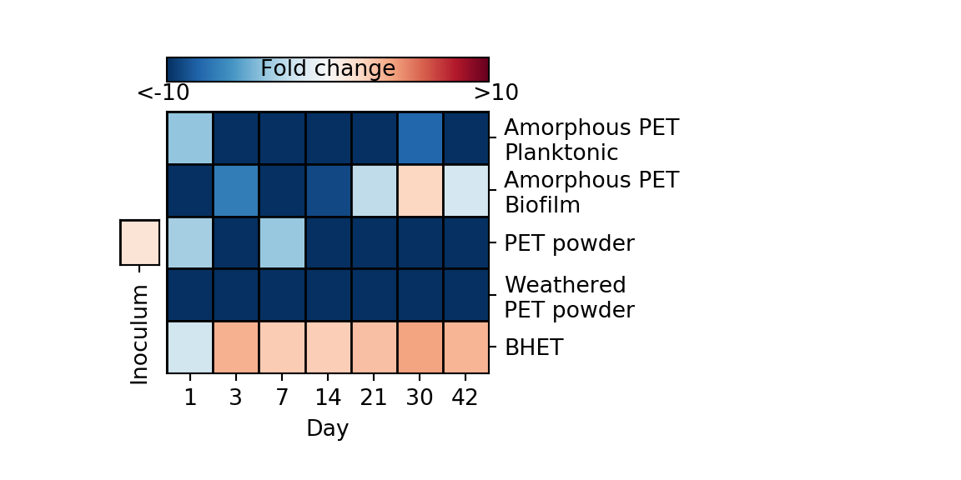
A
B
PET
PETase
BHET
MHET
TPA
tphA2
tphA3
Terephthalate 1,2-dioxygenase
﻿1,6-dihydroxycyclohexa-2,4-
diene-dicarboxylate
1,2-dihydroxy-3,5-cyclohexadiene-1,4-dicarboxylate
dehydrogenase
tphB
Protocatechuate
pcaG
pcaH
Protocatechuate
3,4-dioxygenase
𝛃 -carboxy muconate
𝛃 -ketoadipate
pathway

Slide 2
A
B
PET
PETase
BHET

Slide 3
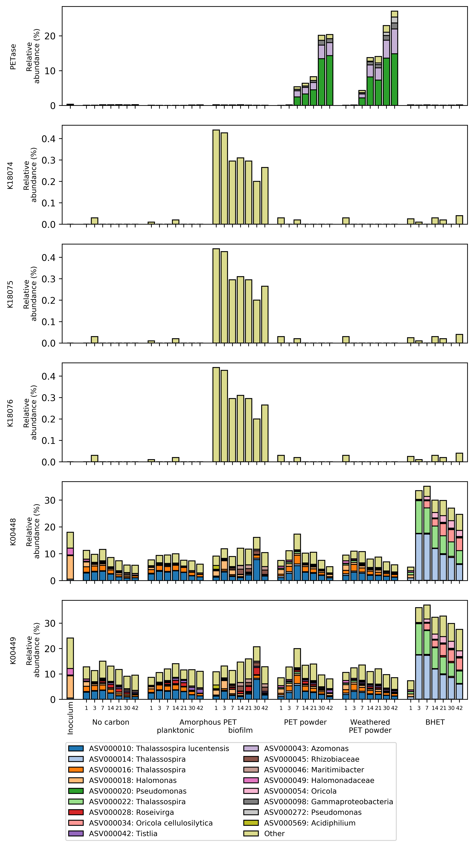
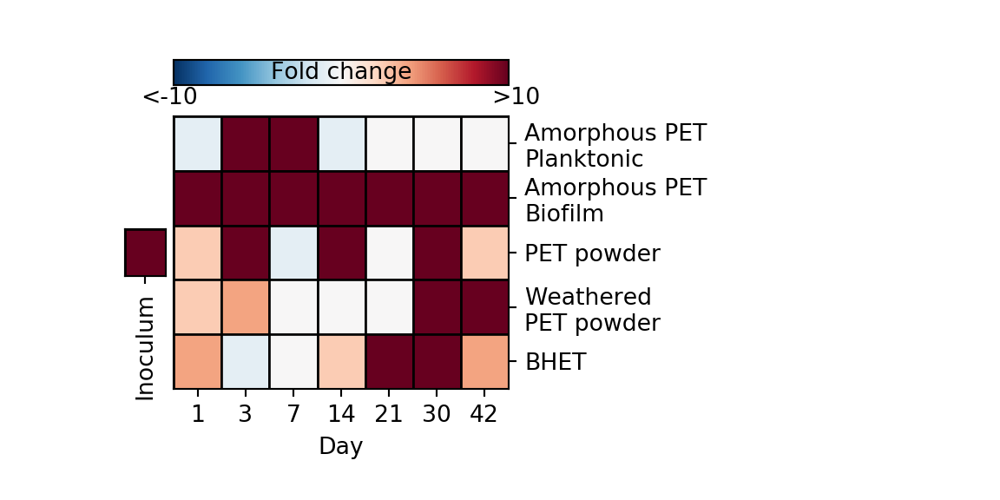
PET
PETase
BHET
MHET
TPA
K18074
K18075
Terephthalate 1,2-dioxygenase
﻿1,6-dihydroxycyclohexa-2,4-diene-dicarboxylate
1,2-dihydroxy-3,5-cyclohexadiene-1,4-dicarboxylate
dehydrogenase
K18076
Protocatechuate
K00448/pcaG
K00449/pcaH
Protocatechuate
3,4-dioxygenase
𝛃 -carboxy muconate
𝛃 -ketoadipate pathway

Slide 4
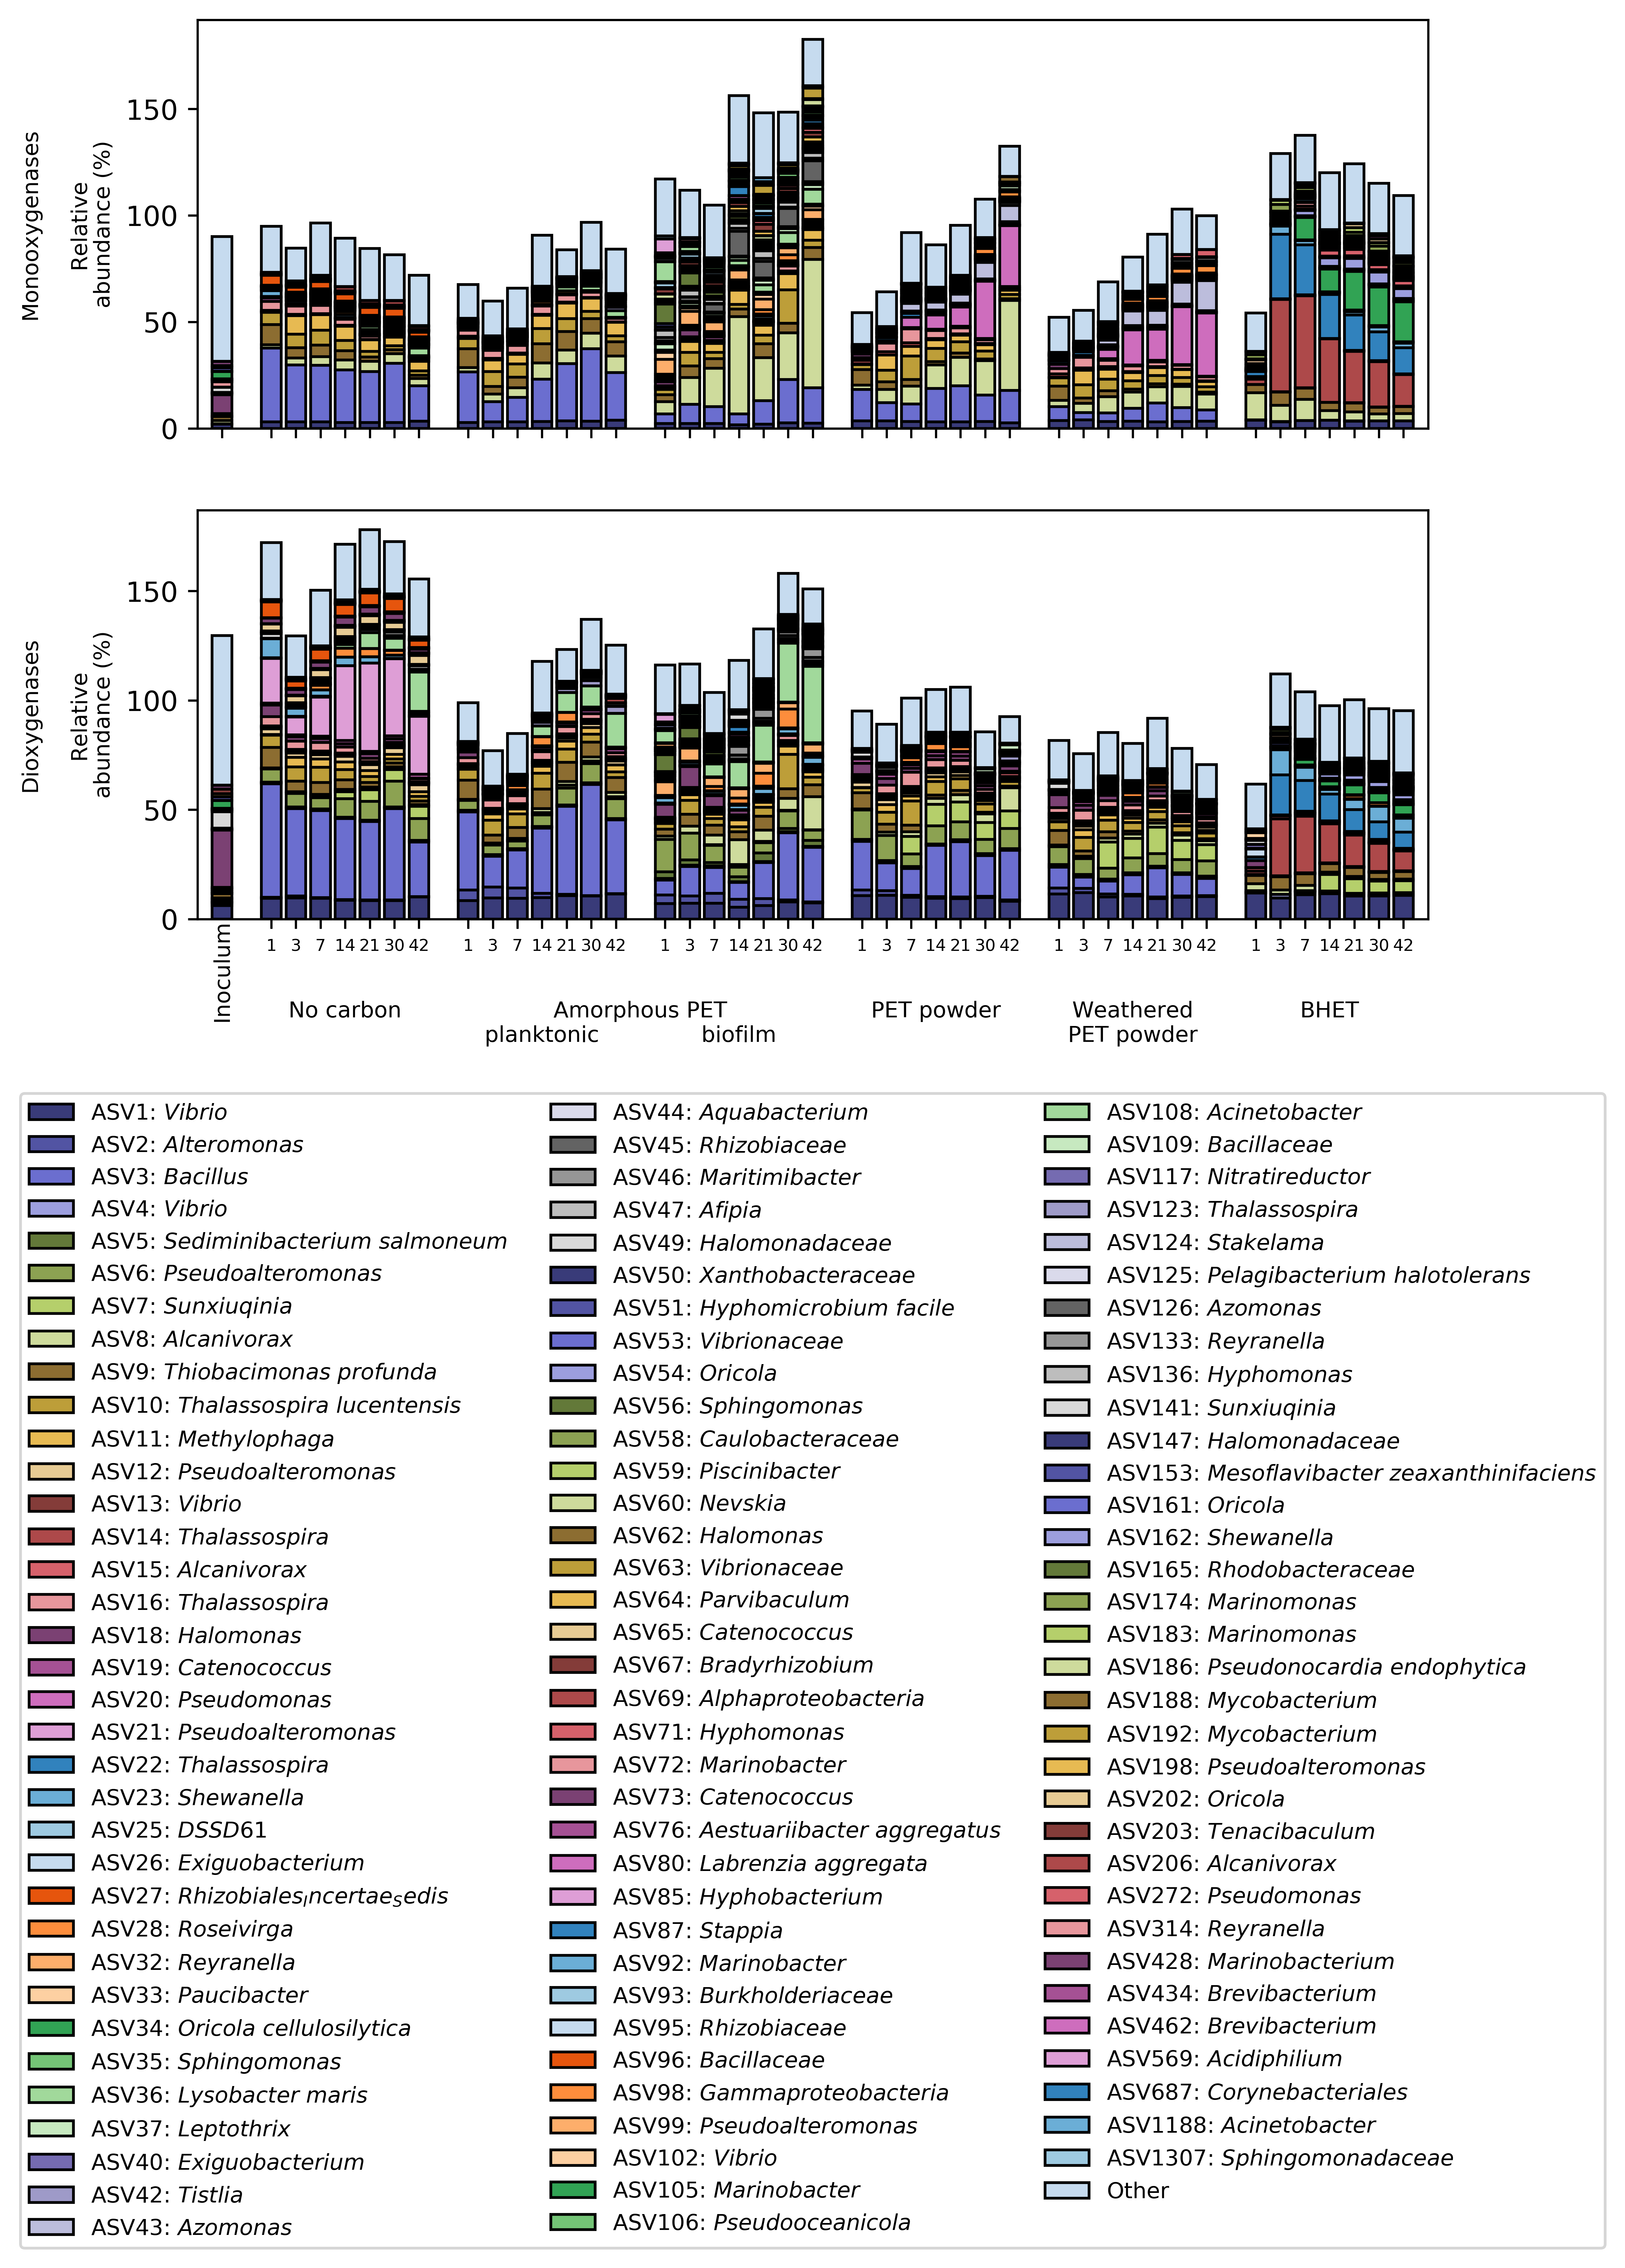
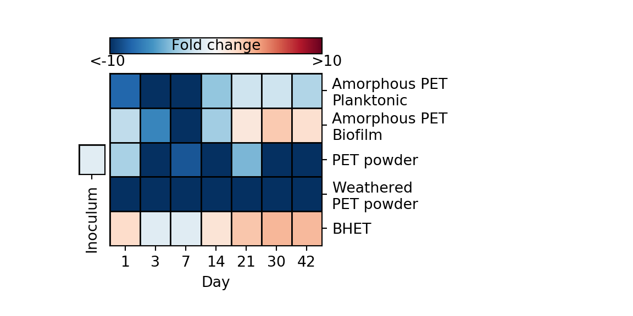
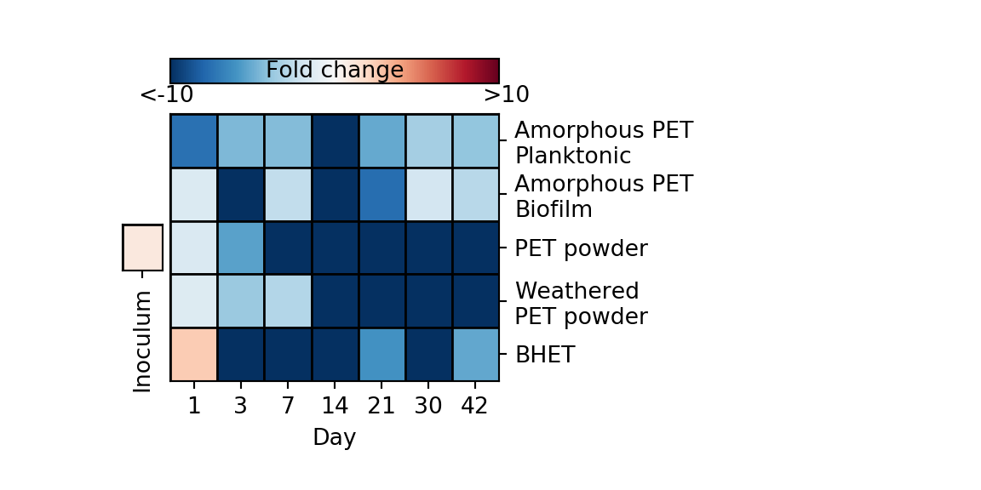
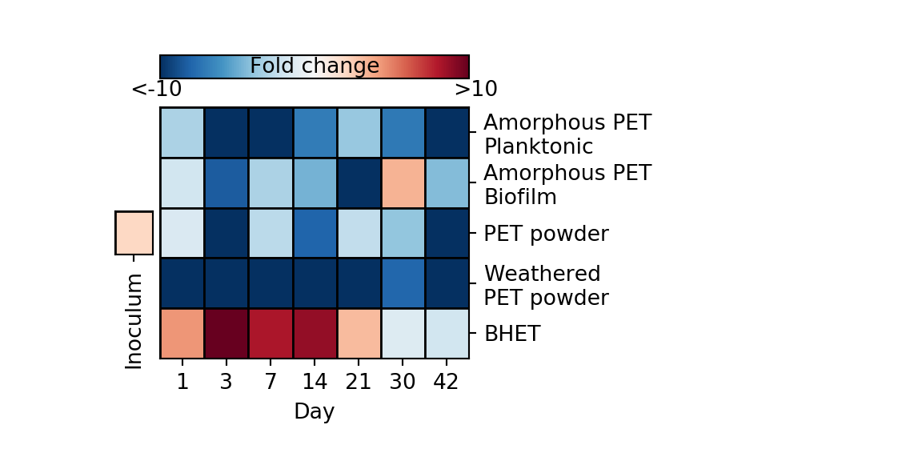
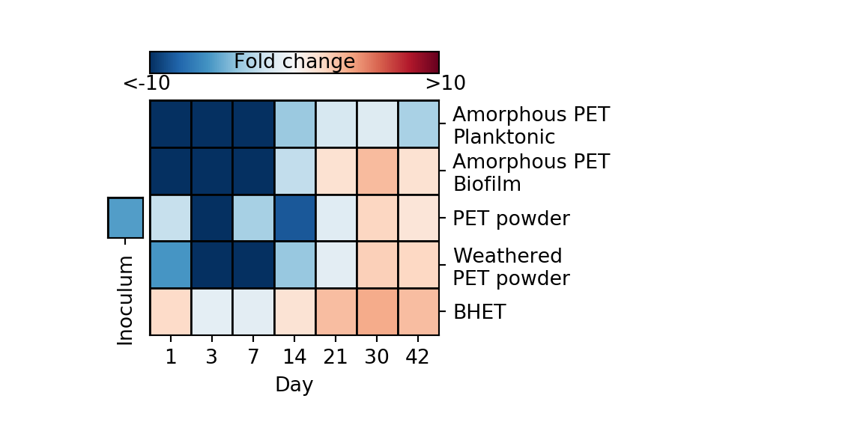
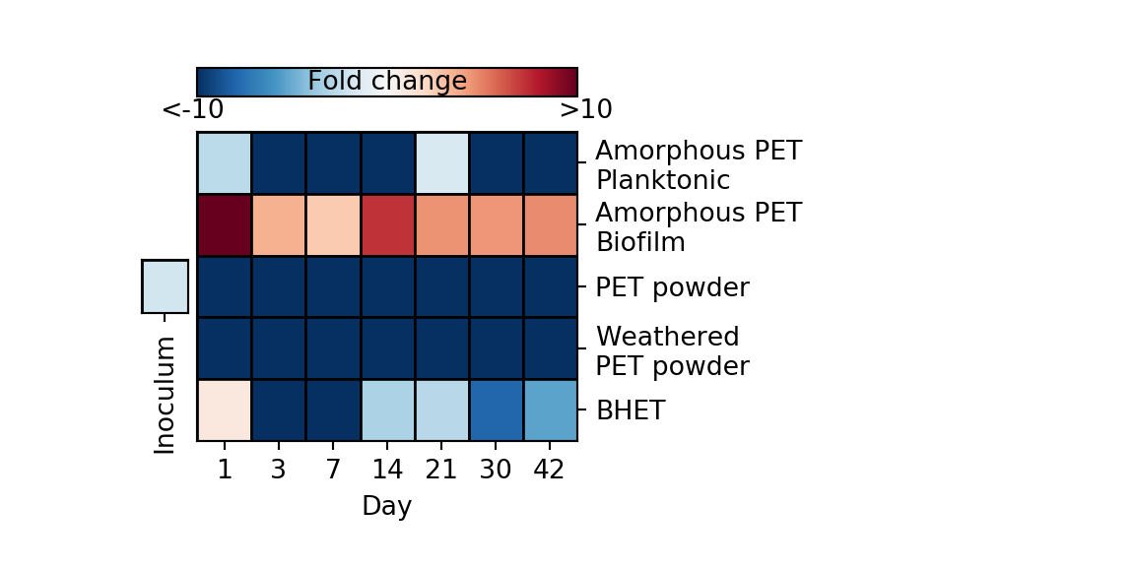
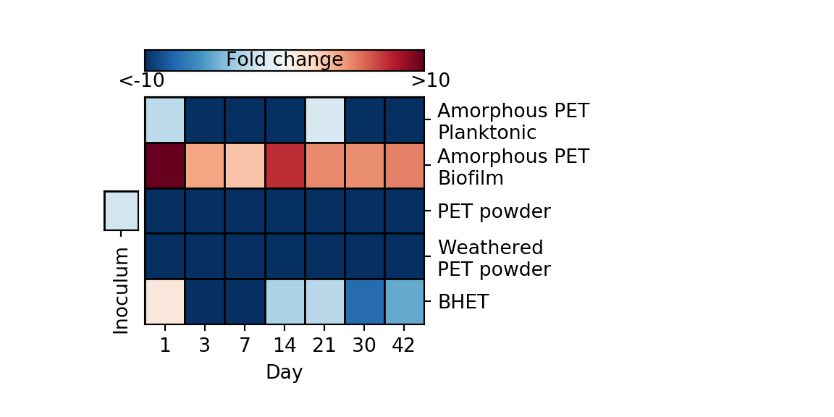


A
B
$β$-carboxymuconate
K01857/pcaB
3-carboxy-cis,cis-muconate cycloisomerase
$γ$-carboxy
muconolactone
K01607/pcaC
4-carboxymucono-
lactone decarboxylase
K14727/pcaL
3-oxoadipate
enol-lactone
K01055/pcaD
3-oxoadipate enol-lactonase
3-oxoadipate
K01031/pcaI
K01032/pcaJ
3-oxoadipate CoA-transferase
3-oxoadipyl-CoA
TCA cycle

